Slide 1
Excel Projects
By Rachel Gardner​

Slide 2
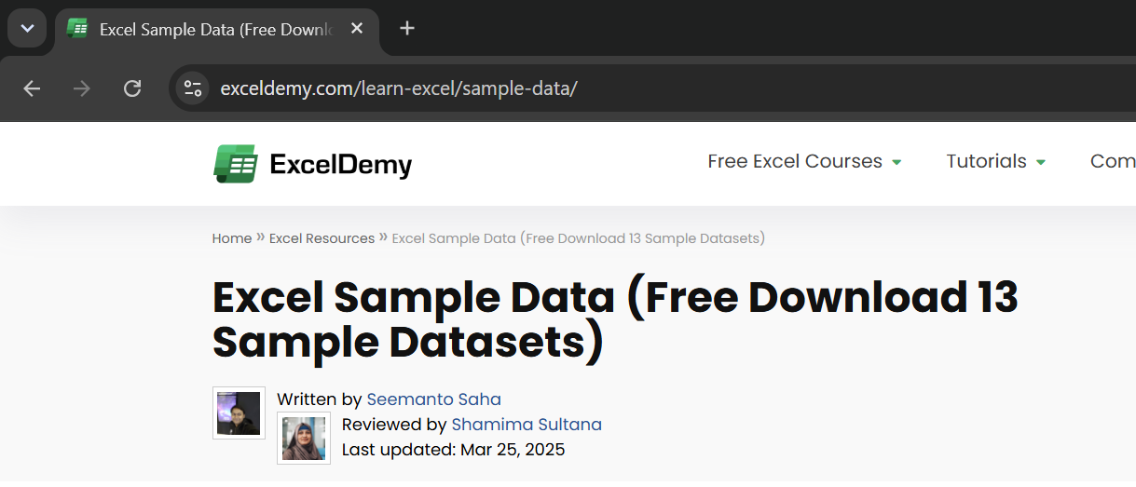
Sample Data Sources​
I find my sample data from ExcelDemy (as seen on the right), which is useful in giving me enough projects to attempt different formulas and lean into asking the right business questions​

Slide 3
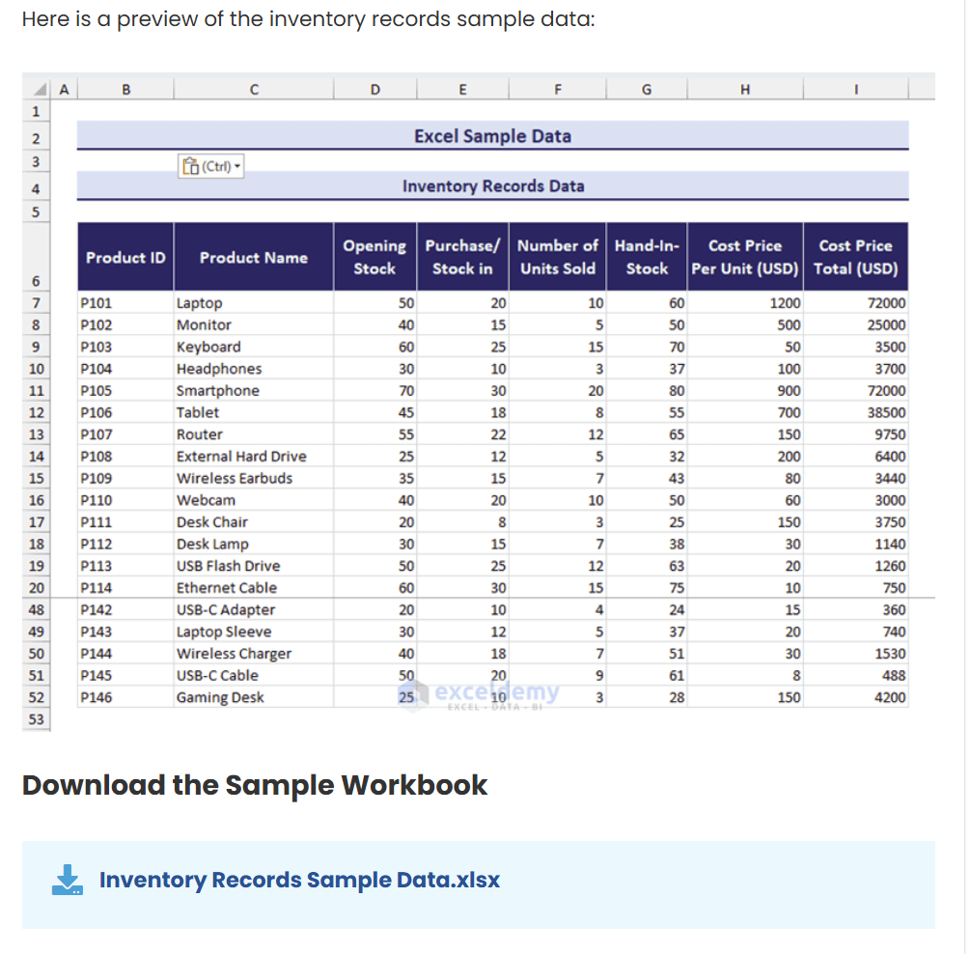
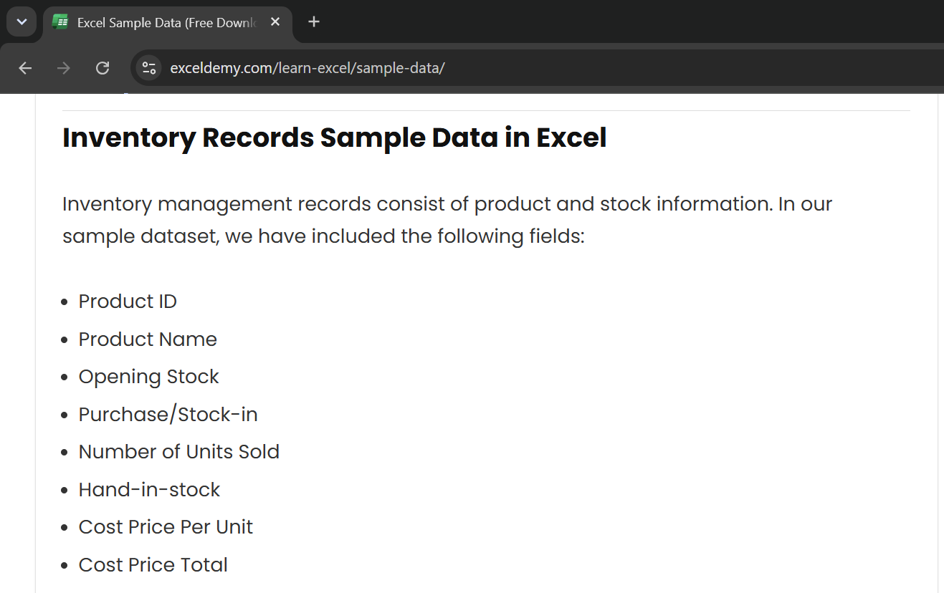
Inventory Records Sample Data Preview​

Slide 4
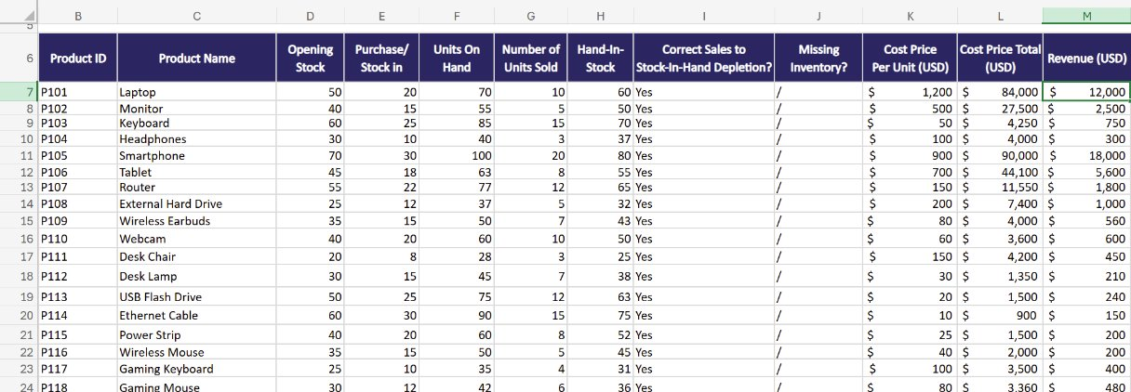
Initial Work on the Data​ – Adding Columns
Checking Hand-In-Stock numbers to both Units Sold and On-Hand​
(minor misspelling of hand-in-stock depletion)​
Verifying which Products
have missing inventory​
Calculating revenue​
Notes:
1 / 2

Slide 5
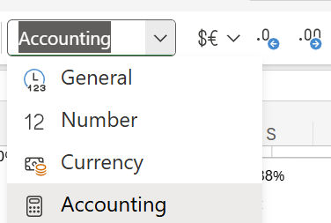
Initial Work on the Data​ – Correcting Number Format
A simple process of switching the number format of columns K-M from General to Accounting, currency to $USD, and decrease the decimal point so the values can be understood more easily.
Notes:
2 / 2

Slide 6
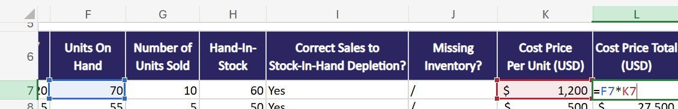
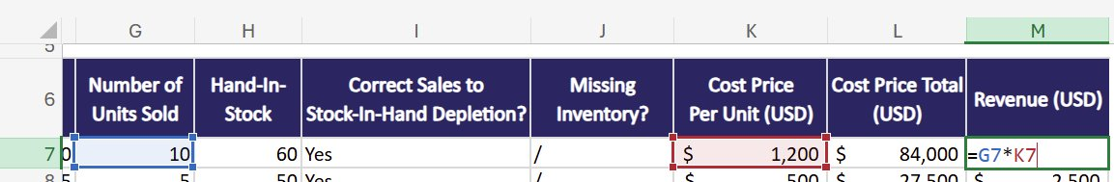
Formulas Used
The revenue made from the unit sales suggests that this dataset, if were real, does not come from a large-brand computer store​
Multiplication of both units SOLD to customers and TOTAL units bought​
$84,000 worth of laptops were bought and $12,000 sold, 1/7th of revenue needed to break even​
Notes:
1 / 2

Slide 7
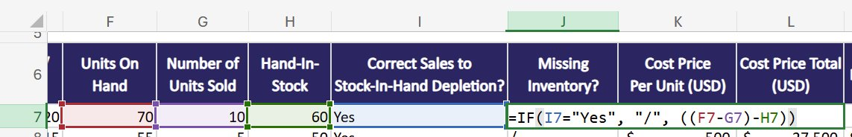
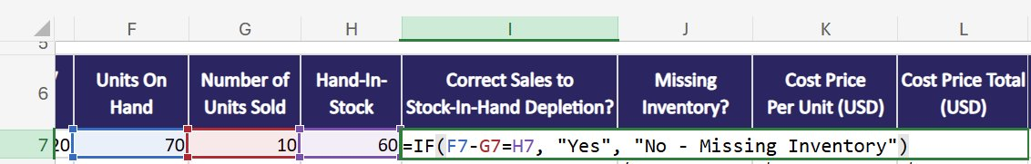
Formulas Used
If-statements used to automatically check whether or not Column H is correct after sales​
And to calculate the difference between Column H and sales subtracted from total units on hand​
Notes:
2 / 2

Slide 8
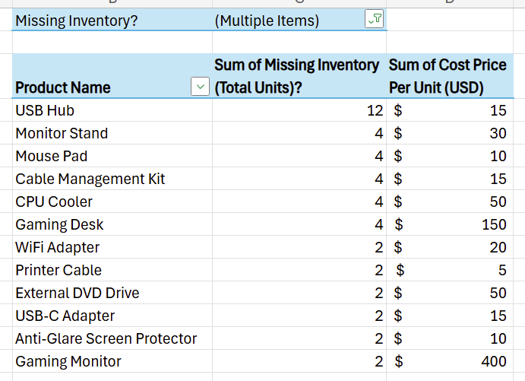
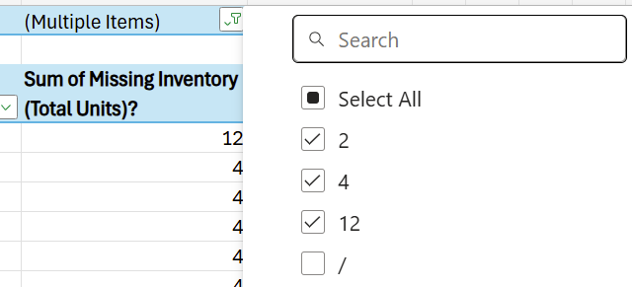
Missing Inventory Compared to Price Per Unit
Pivot table used to filter for just missing inventory and unit cost
Total of 44 missing inventory/discrepancies
With alleged $1,600 unaccounted for in the initial work
Grand total not included as this is a focus on just the products, how many had discrepancies in the sample data, and what each individually cost
Notes:
1 / 3

Slide 9
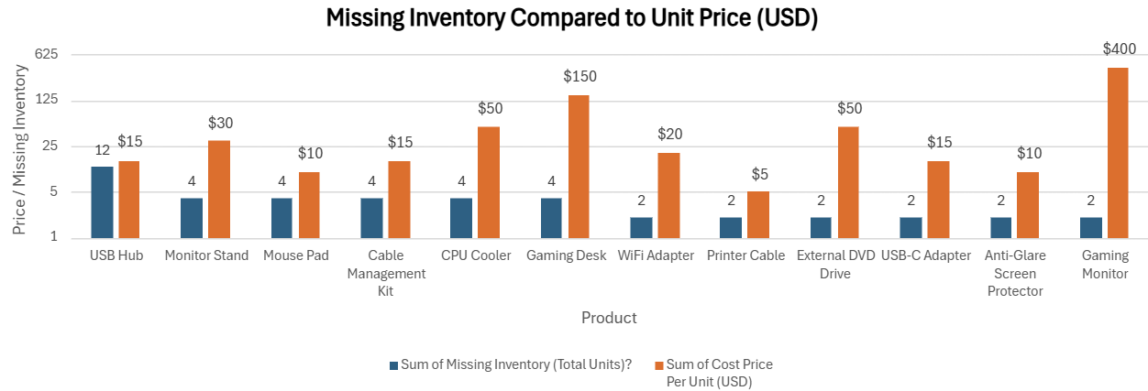
Missing Inventory Compared to Price Per Unit
Clustered bar chart to visualise the data, logarithmically scaled
Most of the missing inventory are in the $5 – $50 range
The inventory discrepancy with the Gaming Desks and Gaming Monitors should be taken note of, regarding their cost
Notes:
2 / 3

Slide 10
Addressing Missing Inventory
The sample data presents with minor data discrepancies, specifically with the hand-in-stock compared to units sales subtracted from total units in the store​
If this were a real spreadsheet of a small to medium-sized computer store, given revenue calculated, then it is necessary to address whether there are actually missing units or not​
If the data inputted was incorrect, then it should be updated immediately in order to avoid further discrepancies with quarterly and yearly revenue insights​
If correct, then finding the missing inventory and identifying whether theft has occurred is also important​
  Security measures should be made accordingly to prevent future losses and theft​
  Misplacement of missing inventory should also make clear of proper product handling during initial deliveries and throughout the day, week, or month​
Notes:
3 / 3

Slide 11
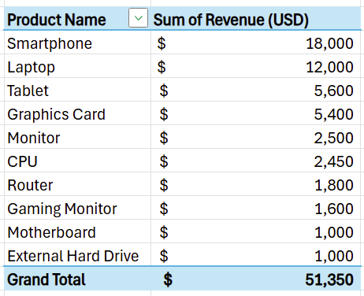
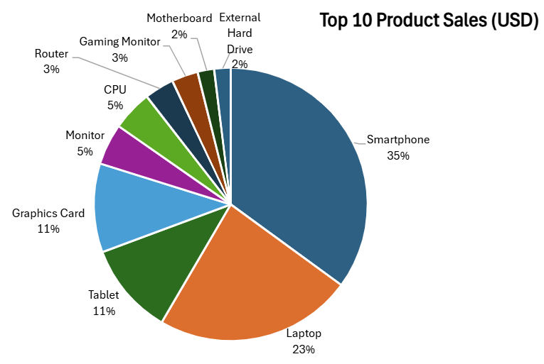
Product Sales
Product sales, visually displayed in a pivot table and pie chart
Smartphones and laptops make up the majority the revenue, which make sense since they are very common and useful for everyday life
Notes:
1 / 5

Slide 12
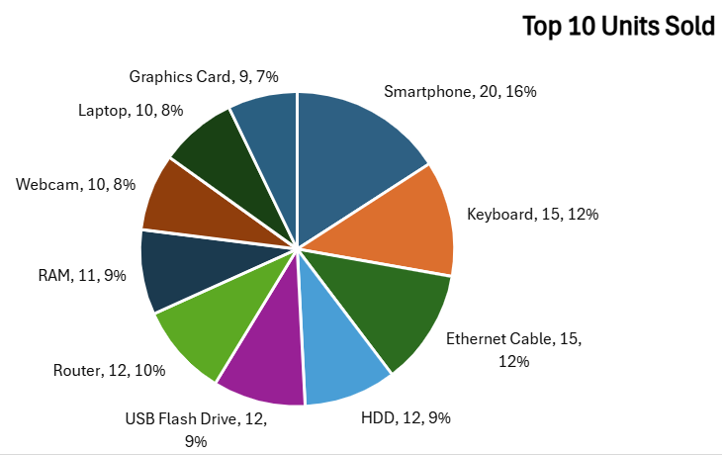
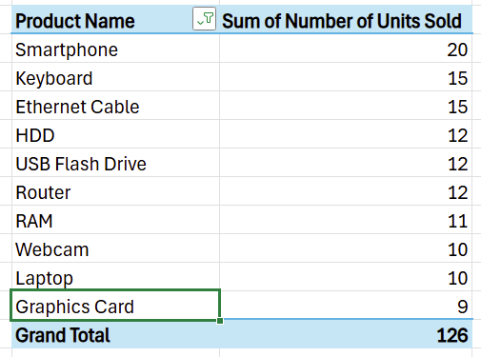
Product Sales
The number of units sold compared to revenue is slightly different here
Graphics cards are now at the bottom when previously they’re 4th, and keyboards are in the chart now when they hadn’t made enough revenue to hit quadruple digits
  While keyboards are popular, the individual unit price isn’t very high
Notes:
2 / 5

Slide 13
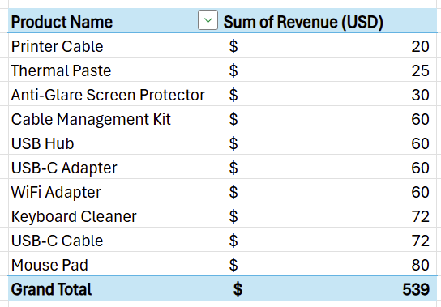
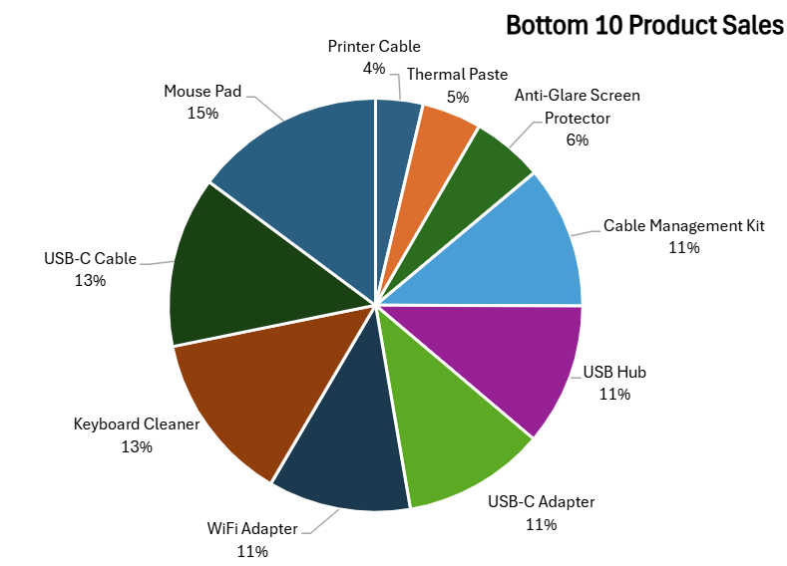
Product Sales
Notes:
3 / 5

Slide 14
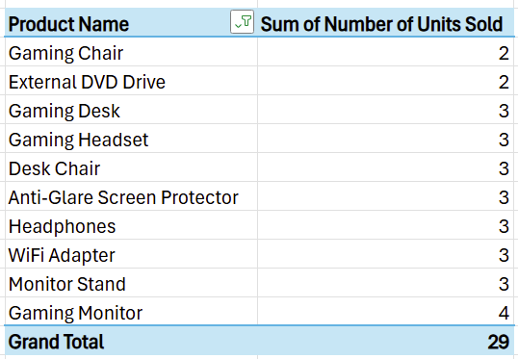
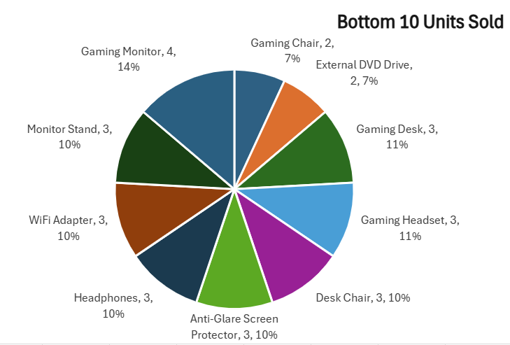
Product Sales
Notes:
4 / 5

Slide 15
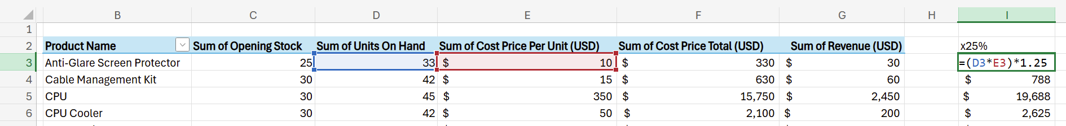
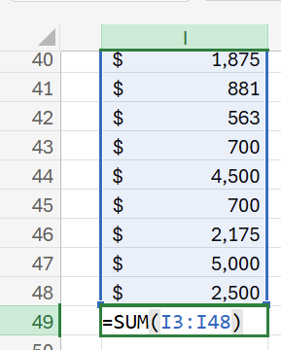

Basic Break-Even and
Profit Calculations
Notes:
2 / 4

Slide 16
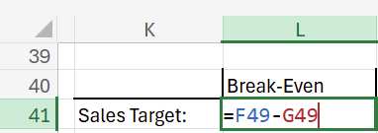
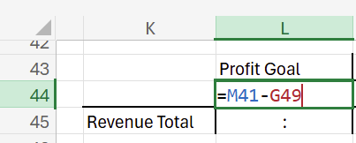
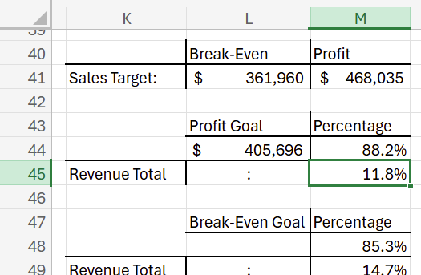
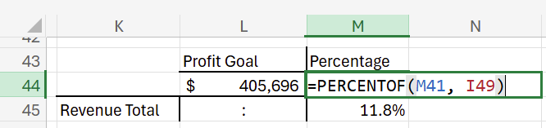
Basic Break-Even and
Profit Calculations
Notes:
3 / 4

Slide 17
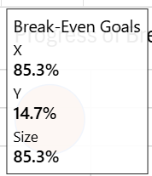
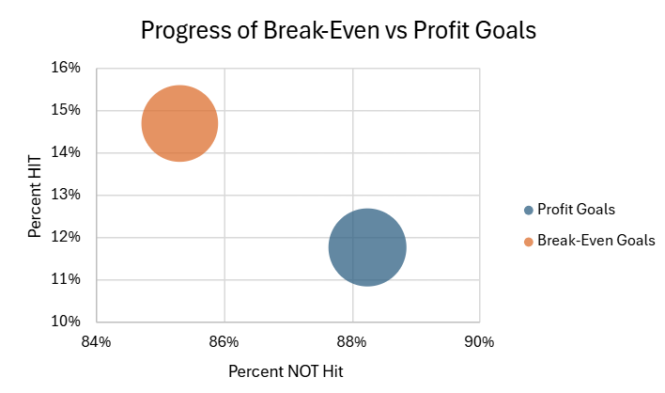
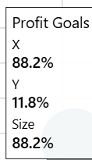
Basic Break-Even and
Profit Calculations

Slide 18
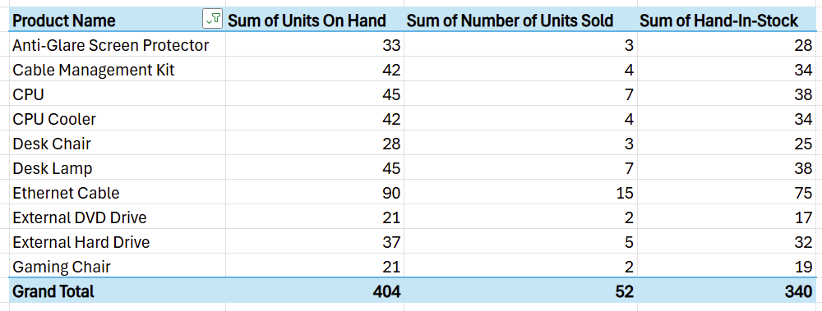
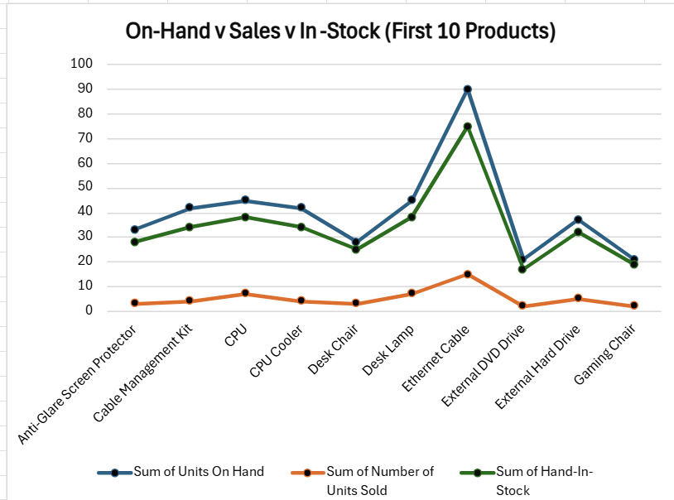
Unit Sales

Slide 19
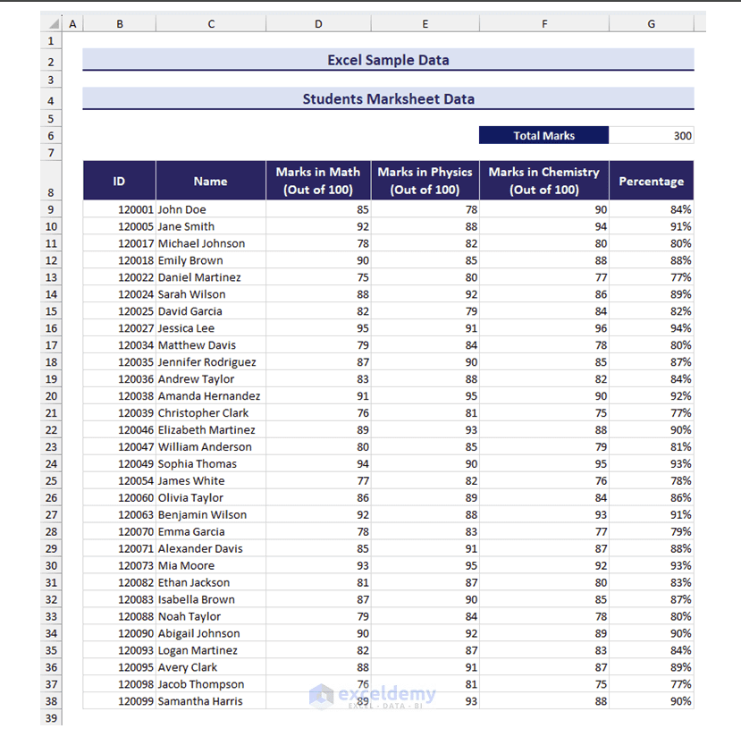
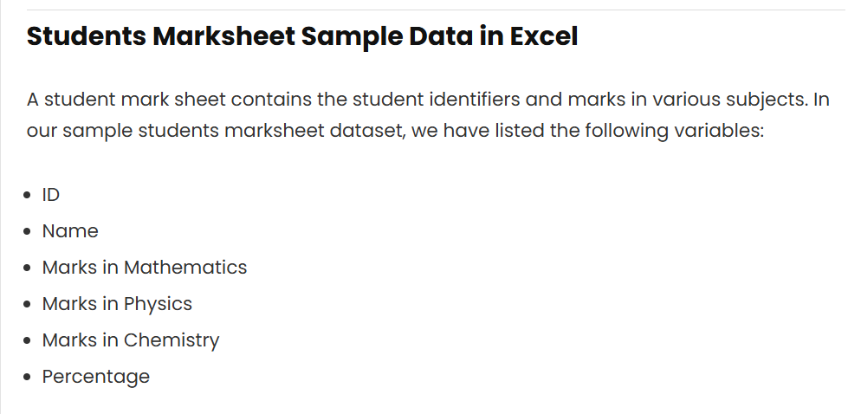
Students Marksheet Sample
Data Preview​

Slide 20
Questions to Ask
Who is the best out of each subject, and who is the best overall?
  Also, who is the worst, and how would we, as a hypothetical teacher, help them?
    Especially if they have previously had lower than average marks, though this would need a larger dataset

